Slide 1


Slide 2
Agenda
Problem Statement 03
Data Mining - 01 04
Data Mining - 02 05
Exploratory Data Analysis (EDA) 06
Data Visualization 07
Algorithms Used 08
Analysis of Results 09
Conclusion & Future Work 10

Slide 3
Problem Statement
The objective of this project is to build a predictive model that can effectively identify the presence of heart disease in individuals based on a set of medical attributes.
The model should take into account various factors such as age category, sex, BMI, Smoking, Alcoholic, Stroke, and other relevant features available in the dataset.
In this project, we aim to develop a machine learning model that can predict the presence of heart disease based on various clinical and diagnostic features.

Slide 4
Data Mining-01
Firstly the data set contains Different data types
Float(64) Data Type - 4
Object Data Type – 1
The shape of the Data Set is 319795, 18 (Rows , Columns)
There are ----- Duplicate values in the dataset we need to delete those duplicate values
After deleting the duplicate values reset the row index
The Ratio proportion of the dataset is balanced with 10.07:1 , hence there is no need to over sampling and under sampling techniques

Slide 5
Data Mining- 02
By using Label Encoding method converting the object data type into int datatype
In the "AgeCategory" column, which represents age ranges, we will perform a transformation by replacing each range with the corresponding mean age value.
The dataset doesn’t have any null values Hence we can proceed for the next step
There is no need to delete any variable in the dataset because all are influencing target variable(HeartDisease)

Slide 6
Exploratory Data Analysis (EDA)
In the dataset the target variable is “HeartDisease” because our machine learning model is to predict the person who have heart disease or not
And all other are independent variables because all are influencing the target variables.
After identifying the target variable we can split the data set into train and test data by using sklearn train_test_split() method
After dividing the dataset into train and test, train data is used to train the model algorithms and test data is used to test the accuracy of the model algorithms

Slide 7
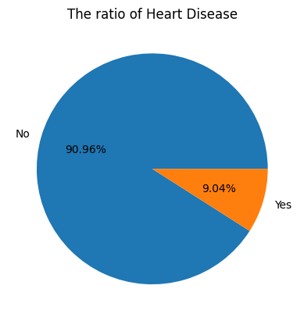
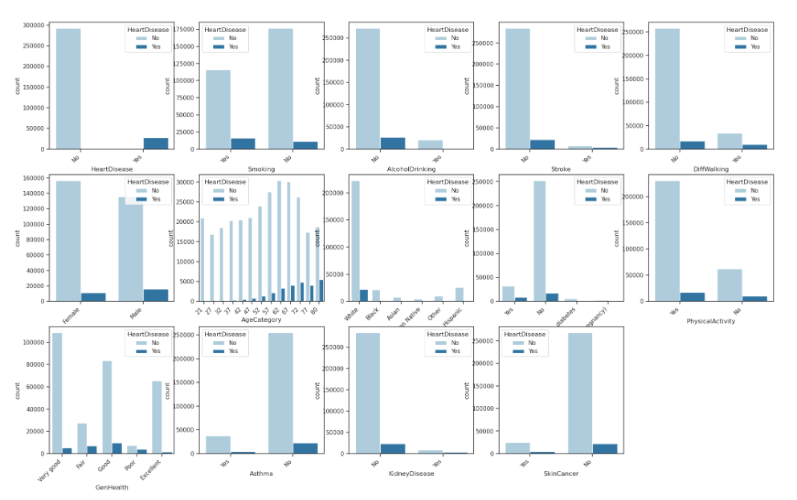
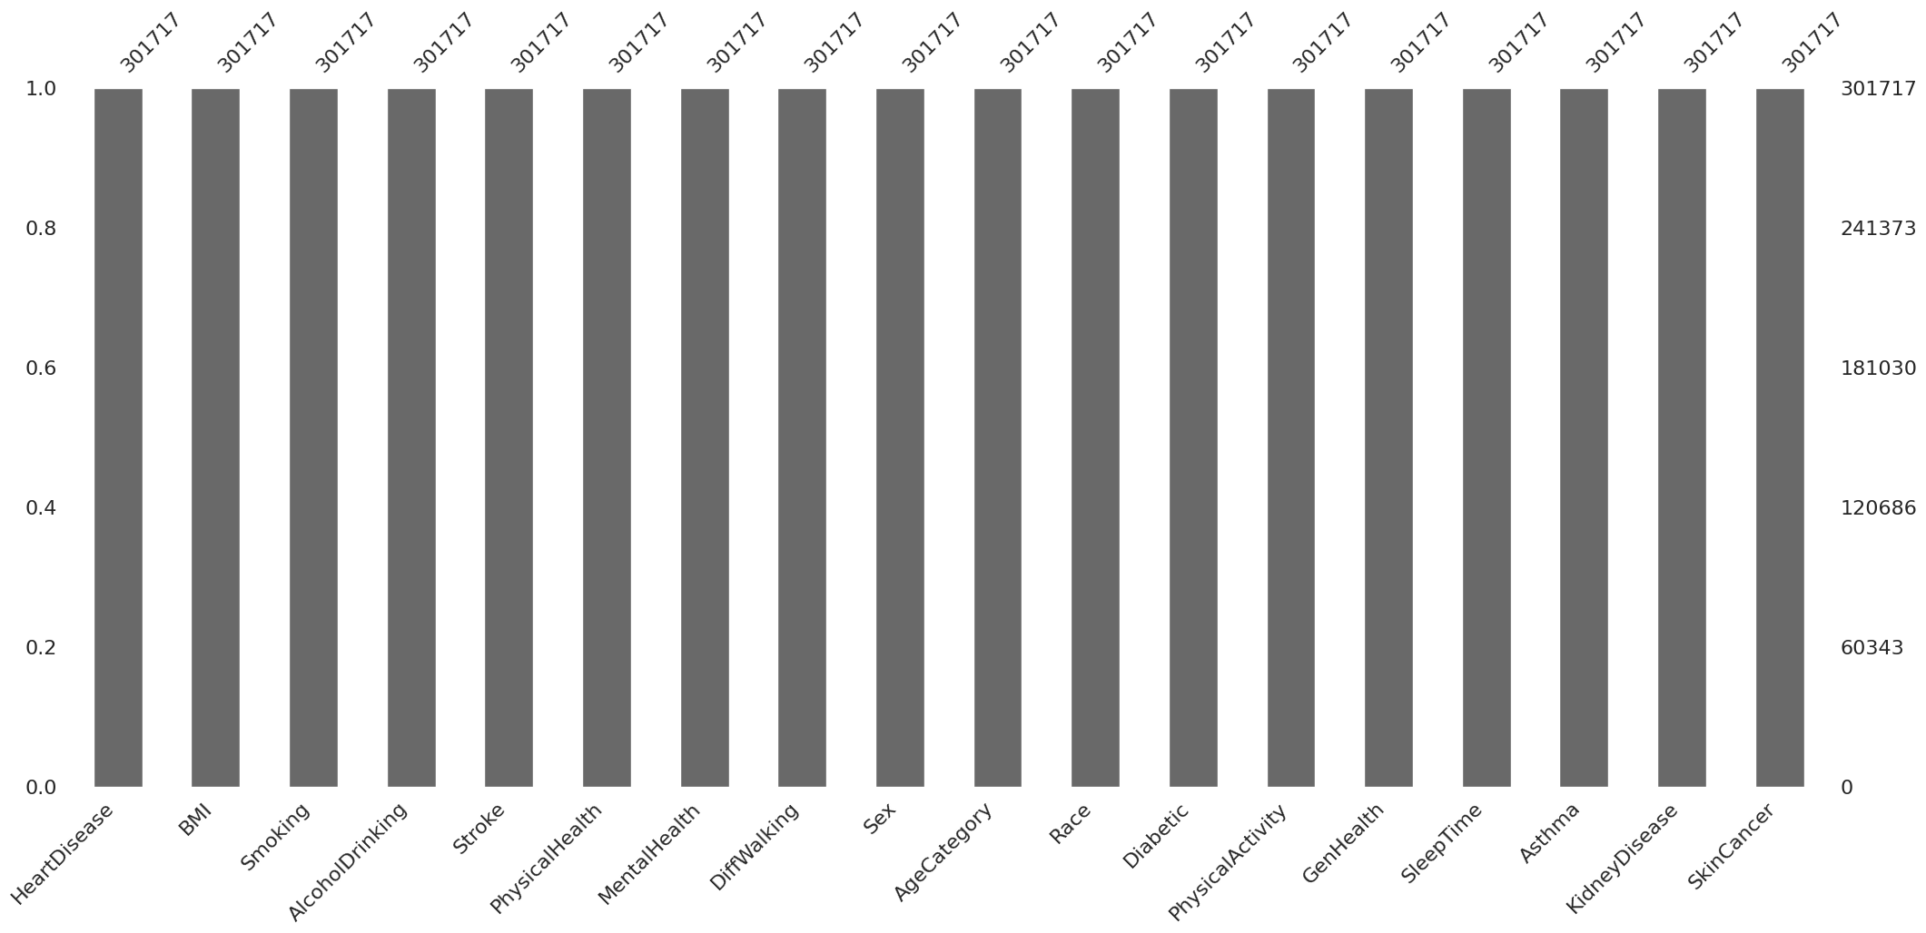
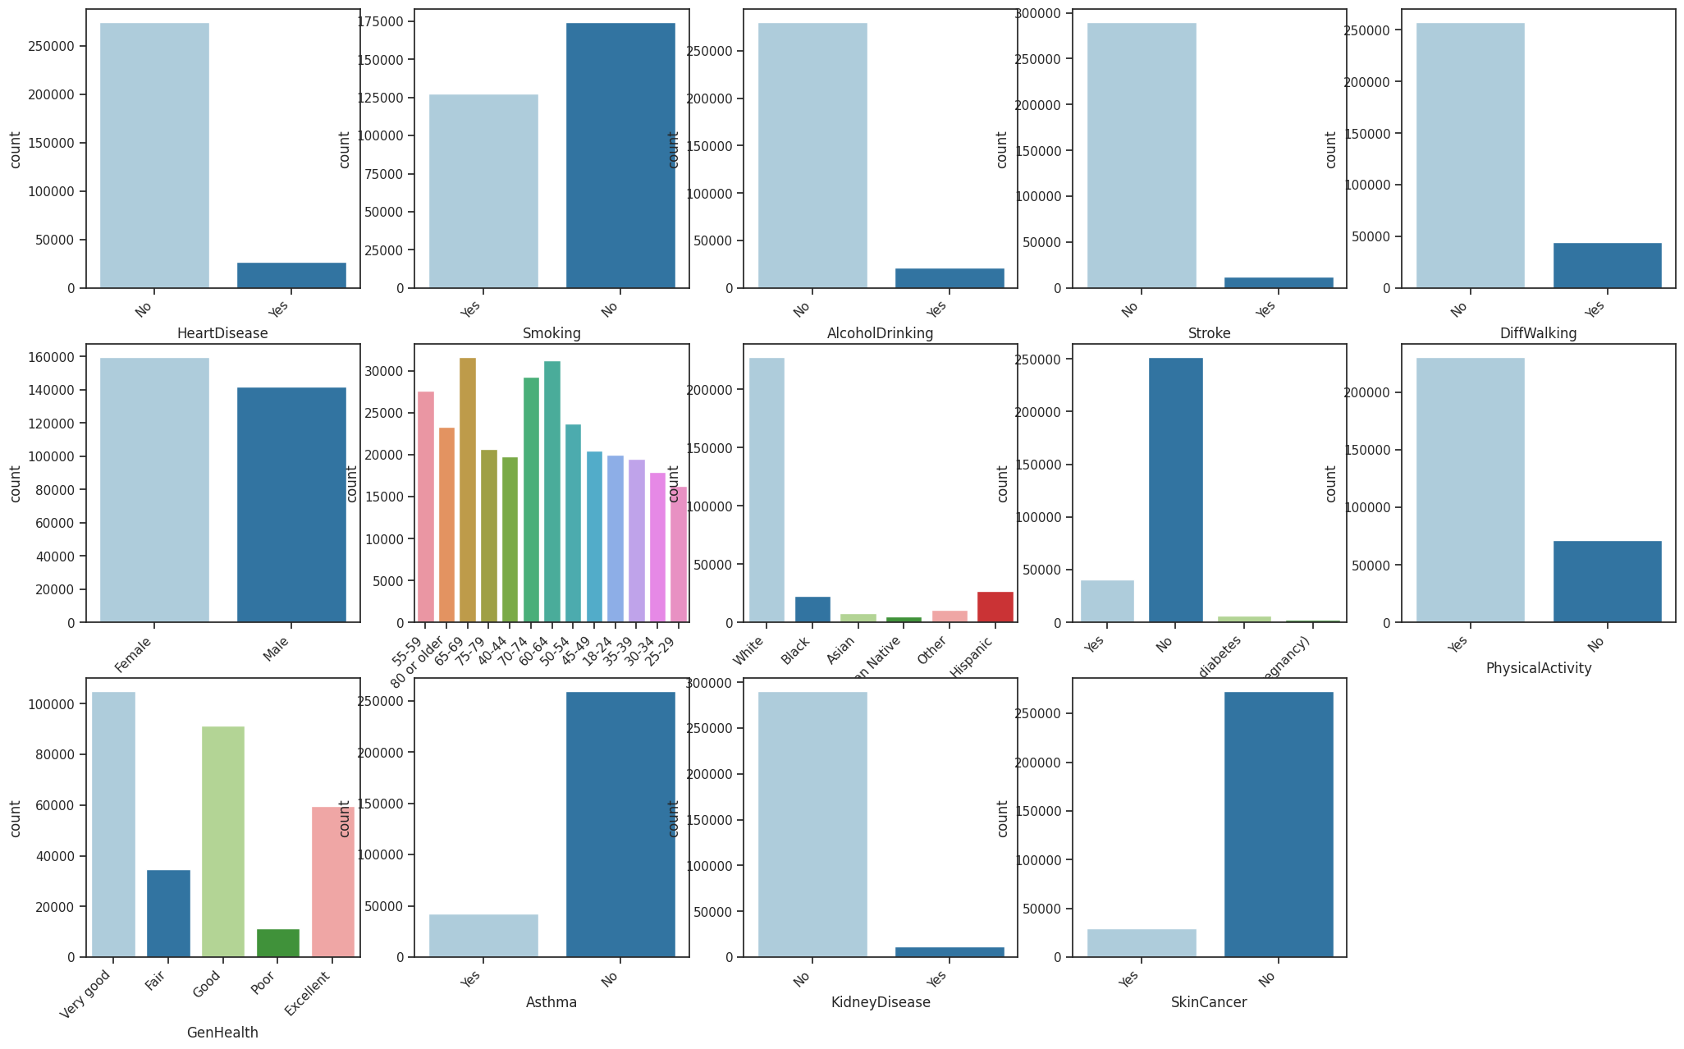
Data Visualization

Slide 8
Algorithms Used
Our problem is classification problem.
There are total seven algorithms in classification problems
Logistic Regression
Decision Tree Classification
Random Forest
Extra Trees Classification
KNN Algorithm
SVM Algorithm
Naïve Bayes Algorithm
Among 7 algorithms, in KNN algorithm there is a need to find the highest accuracy k value
And also there are 4 types of models are there in SVM Algorithm

Slide 9
Analysis of Results
From KNN Algorithm k=20 gives the best accuracy
From SVM Algorithms SVM – Linear gives the best accuracy
Hence KNN at k=20 and SVM – Linear selects and comparing with other algorithms

Slide 10
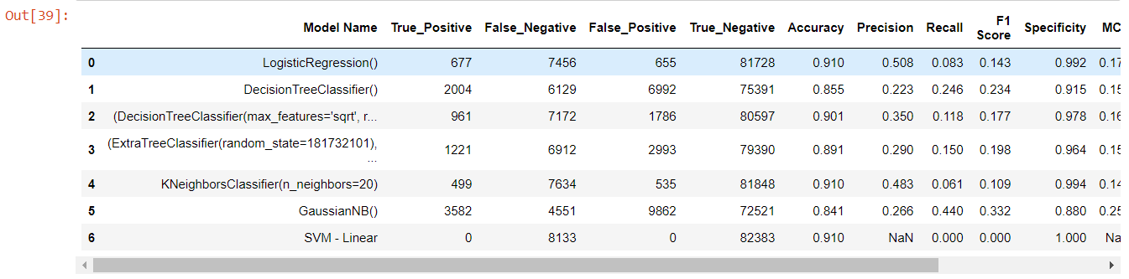
Conclusion and Future Work
After evaluating various algorithms, we have found that K-Nearest Neighbors (KNN) achieves the highest accuracy among them
Therefore, we will utilize the KNN algorithm to predict the presence of Heart Disease in our model

Slide 11
Thank You
Q & A
Student Name : Jaikumar Buddi
Roll Number : 21B91A0551
SRKR Engineering College
Mobile: +91 9381466583
Email: 21b91a0551@srkrec.ac.in
Bhimavaram - India

